Slide 1
Legal Documents
Reviewed 4/26/2024
How to identify

Slide 2
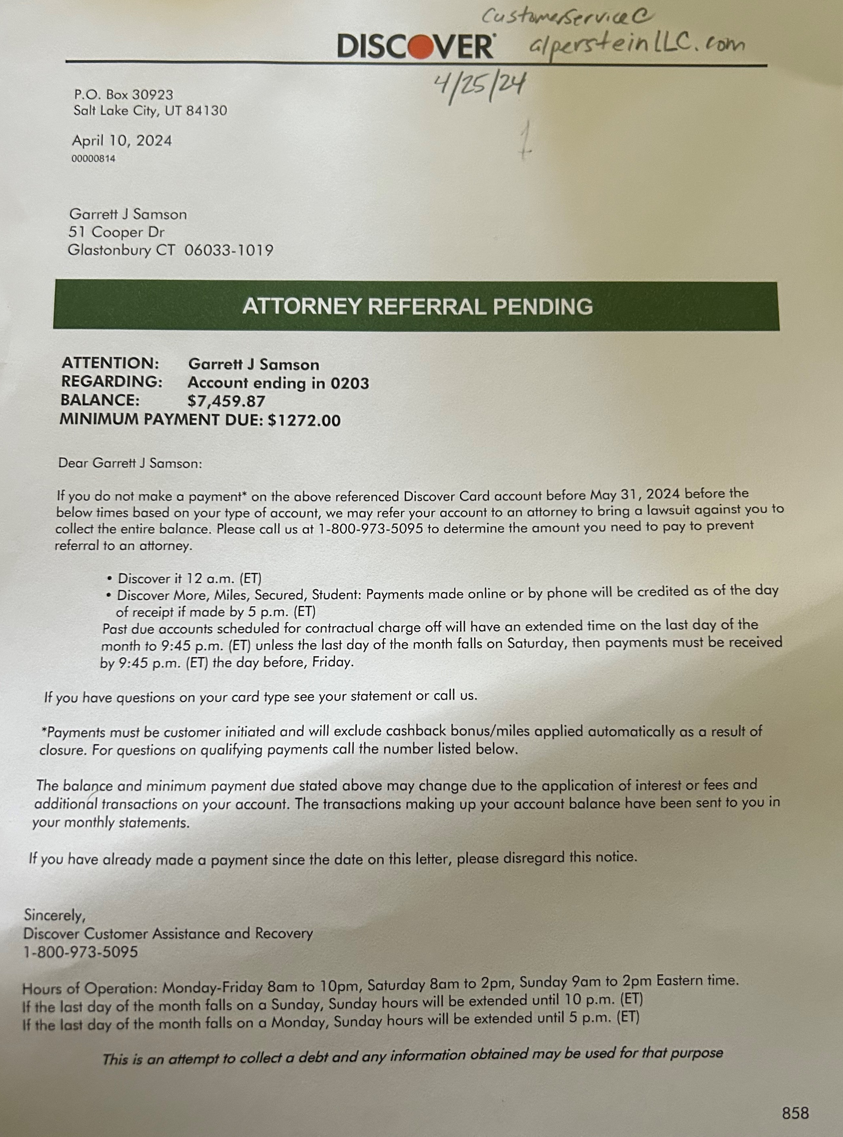
Past Due Notices
Past Due notice are sent from the original creditor
Talking Points
Please keep in mind that these types of notices are normal practice in this program and to be ignored. Unfortunately, legal threats are normal because if the creditor is successful in getting you to make a payment directly to them, then they will not have to work with our negotiator.

Slide 3
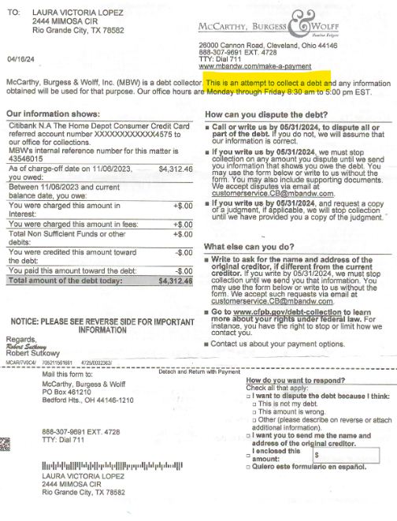
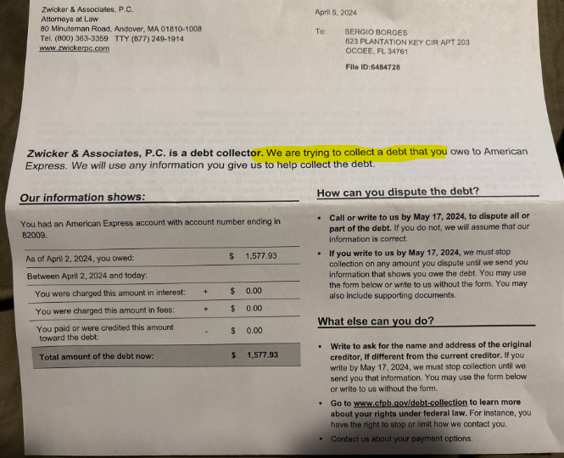
Collection Notices
Collection notices are sent from a 3rd party that represent the original creditor in collections.
Talking Points:
It is normal for the accounts to change hand during this program. If you receive any notices from the new agencies, please send those over to us and we will update that account. The negotiators will reach out to the new agency for the settlement. Some creditors are known to use law firms to assist with the collection process.

Slide 4
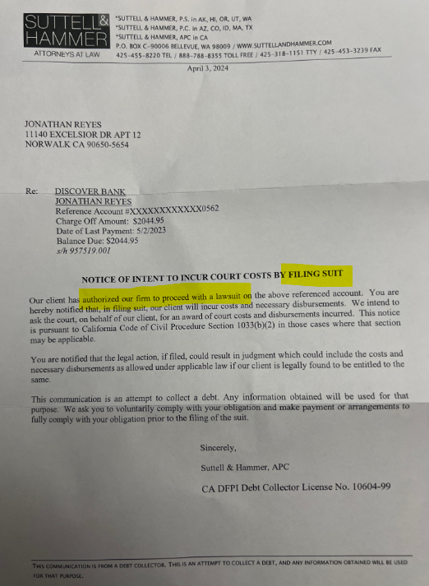
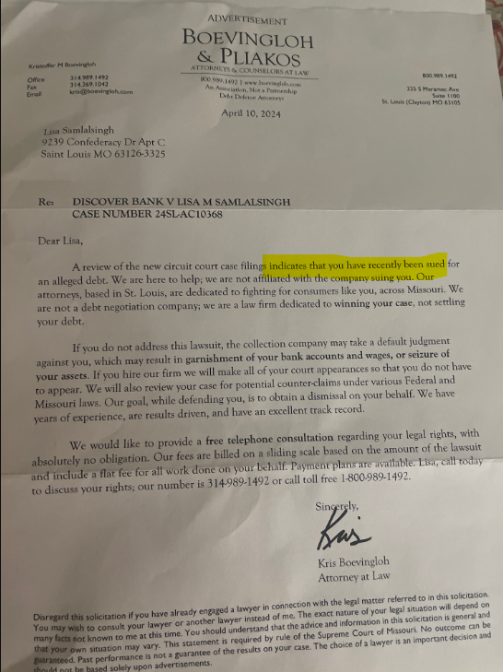
Intent to File
Our clients may receive letters in the mail from the collection law firm and from bankruptcy attorney’s advising that legal documents have been filed.
We need to let the client know those documents are not helpful to the negotiator but to keep us updated if they are served legal documents and to upload to the portal immediately for us to review and advise on the steps needed to expedite a settlement agreement.

Slide 5
Legal Documents
Summons
Notice of Trial Setting/Appearance Notice
Judgment
Garnishment
Stipulation

Slide 6
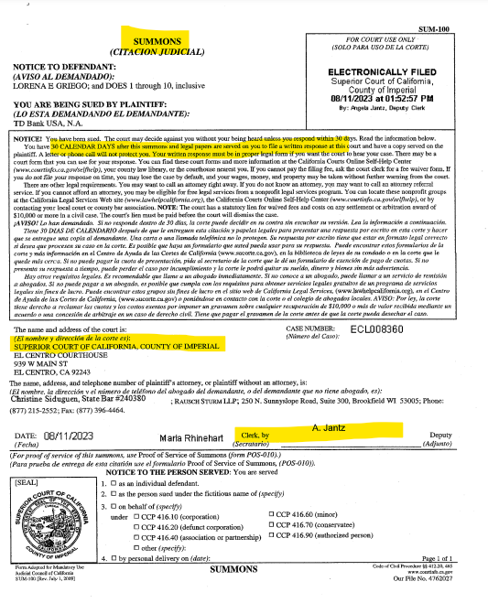
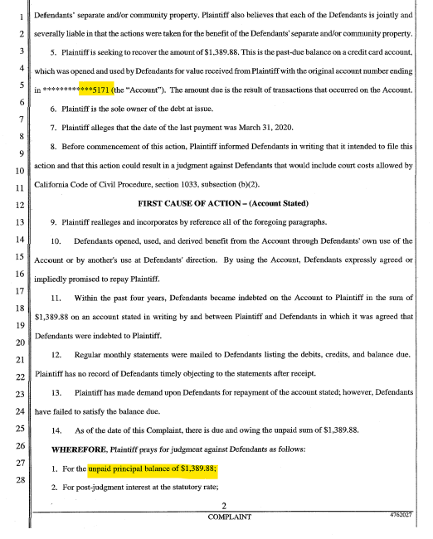
Summons Examples

Slide 7
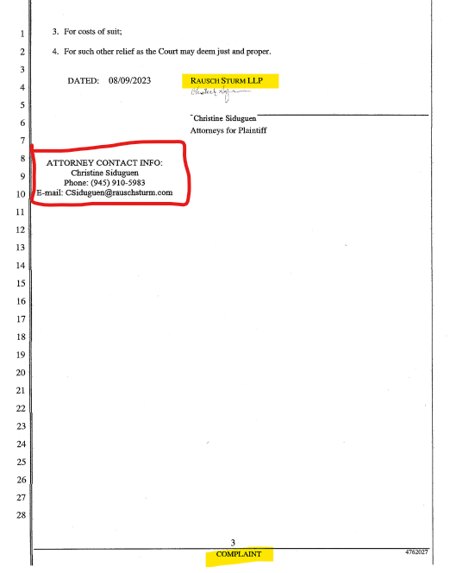
Summons Examples

Slide 8
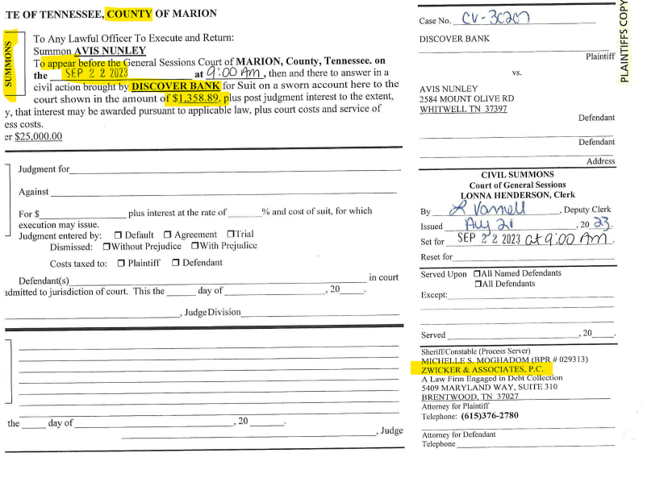
Summons Examples

Slide 9
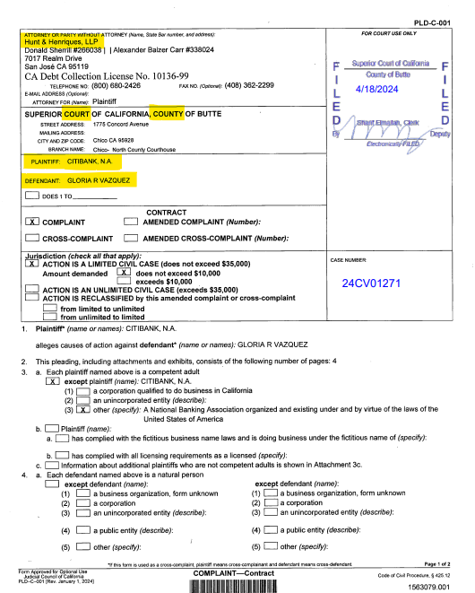
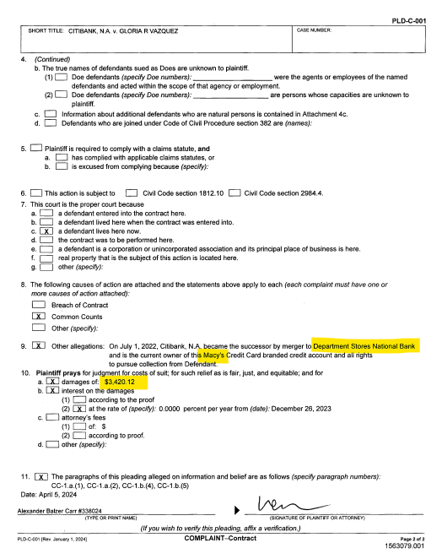
Summons Examples

Slide 10
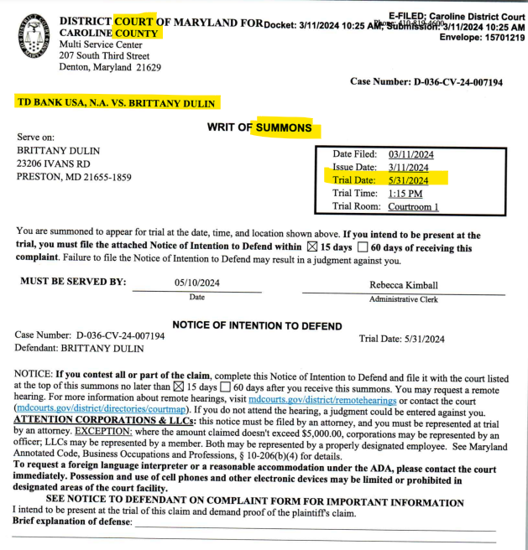
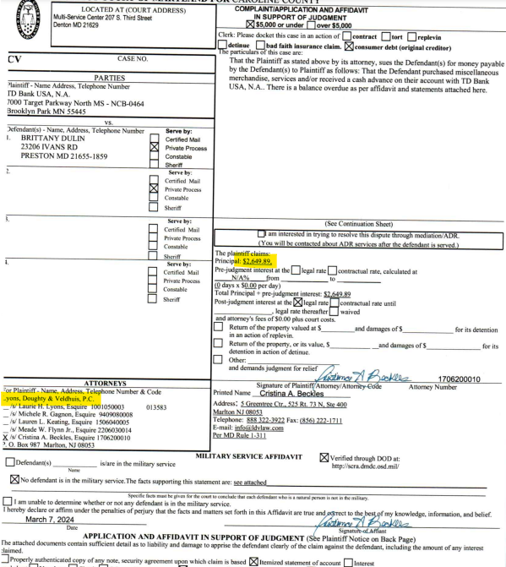
Summons Examples

Slide 11
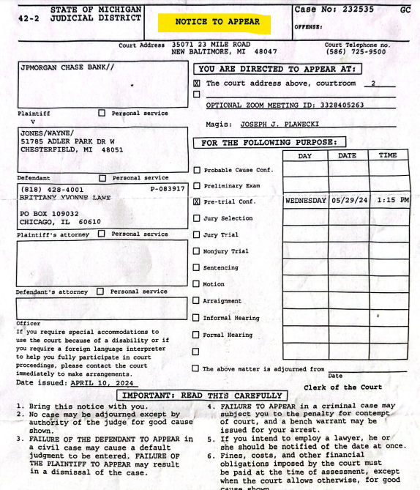
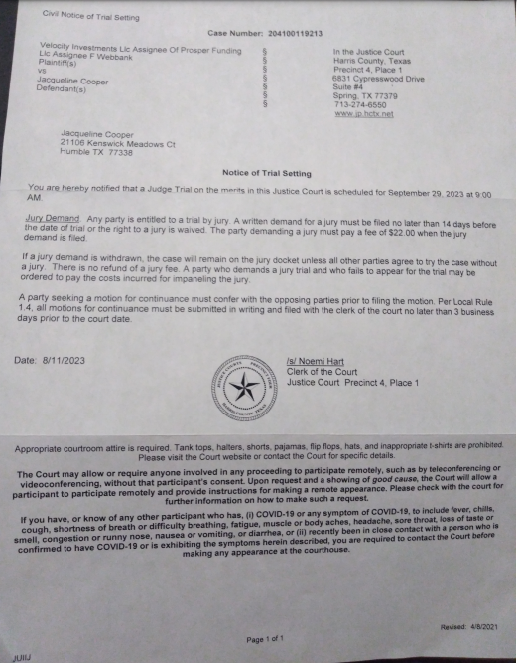
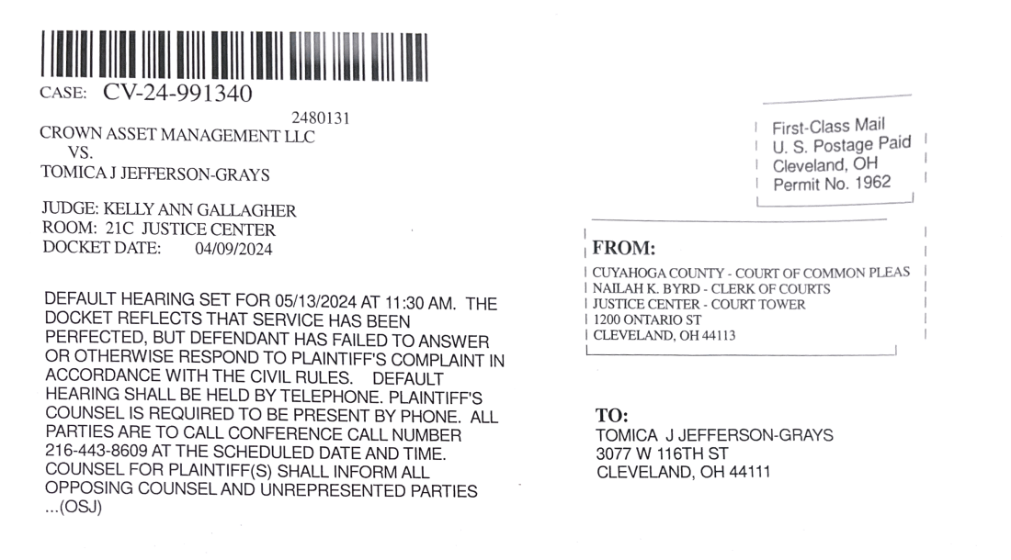
Notice of Trial Setting/Appearance Notice

Slide 12
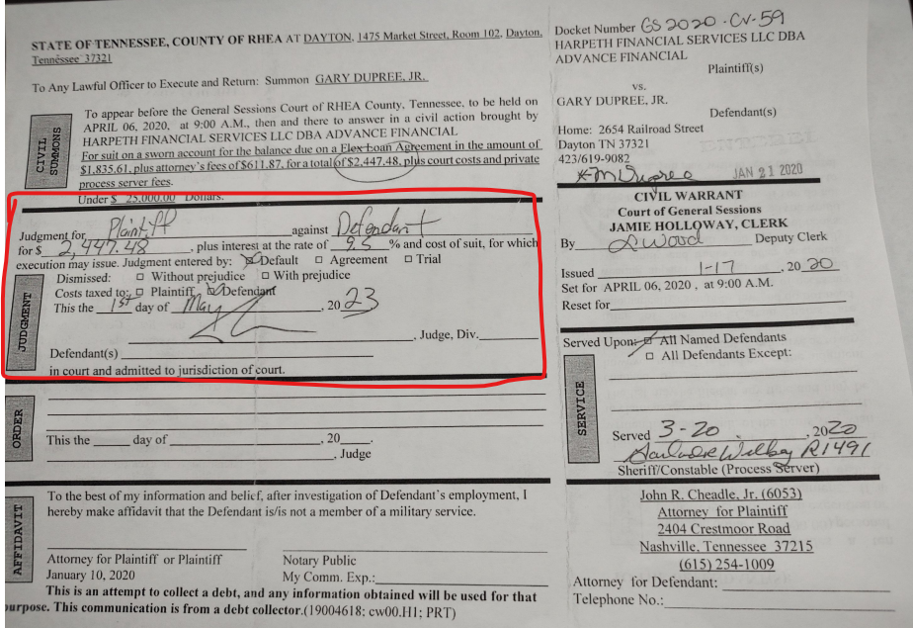
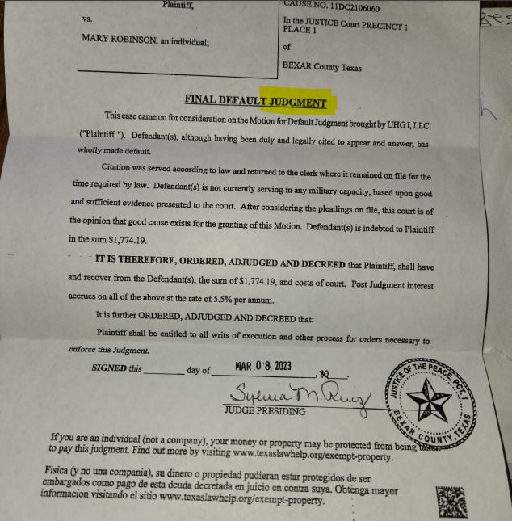
Judgment

Slide 13
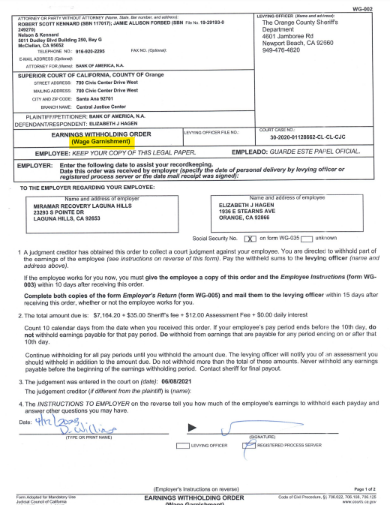
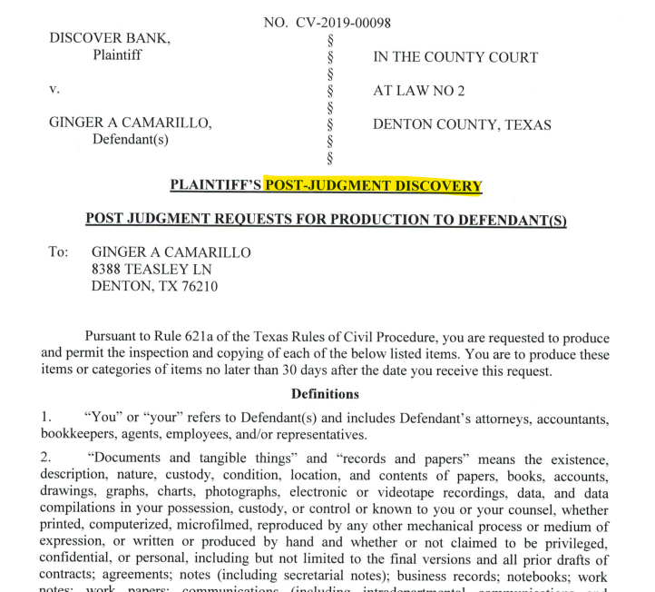
Garnishment
Once the account is awarded a garnishment, the creditor is no longer willing to negotiate a settlement since the garnishment will allow them to collect the full balance directly from the client.
At this point, we need to advise the client to remove the account to work.

Slide 14
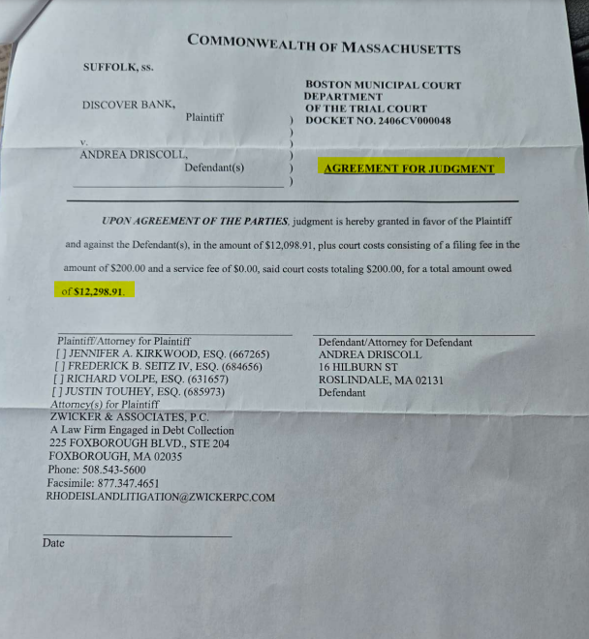
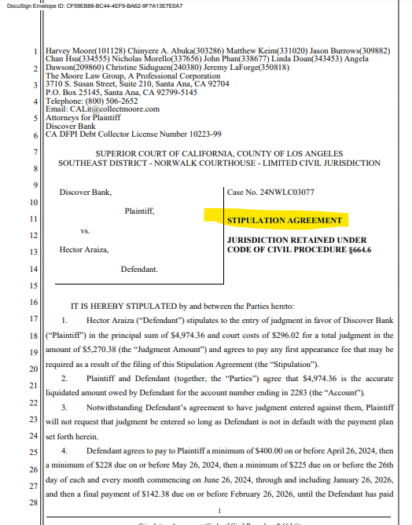
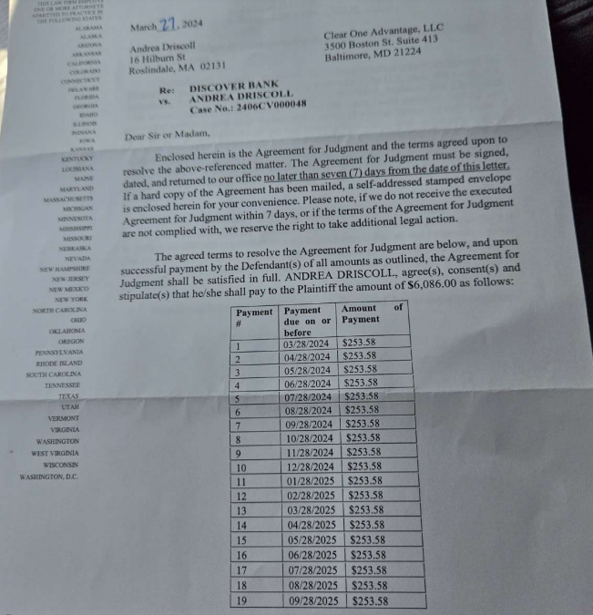
Stipulation
A stipulation is the settlement agreement on a court document, that shows the court the client has agreed to those payments.

Slide 15
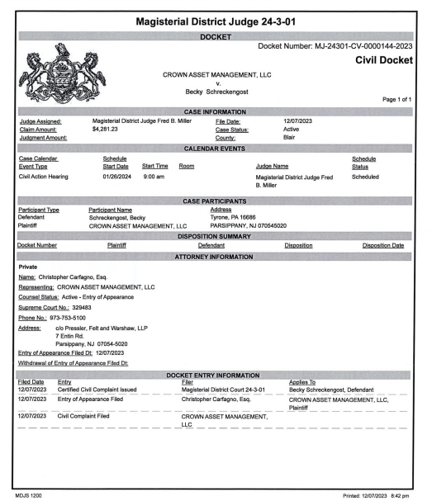
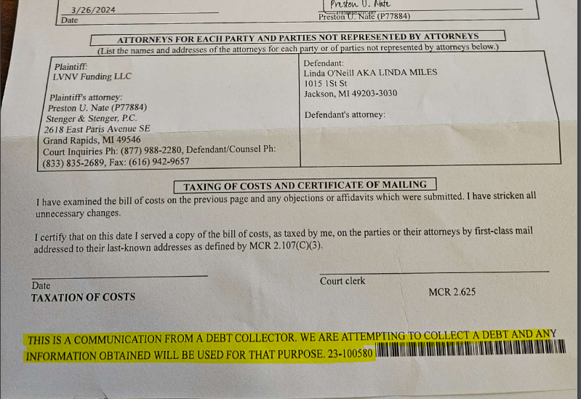
Things to look for

Slide 16
Legal - Settled
Yes, an intake is needed even though the account is settled.
No, additional funds should not be needed for negotiations but please check the calc to ensure there is not a shortfall that would create an issue
Check for the filing date to see if the date was before to the settlement date, that would mean they filed with the court just before we were able to reach that settlement agreement.
After we submit the intake, you will need to email Evan Davis the client link, the intake link, the legal documents, and a summary about what is needed from his team to confirm the settlement agreement and the timeframe they are working against.
Advise our client that the negotiator will follow up with the law firm about the settlement agreement due to those documents.

Slide 17
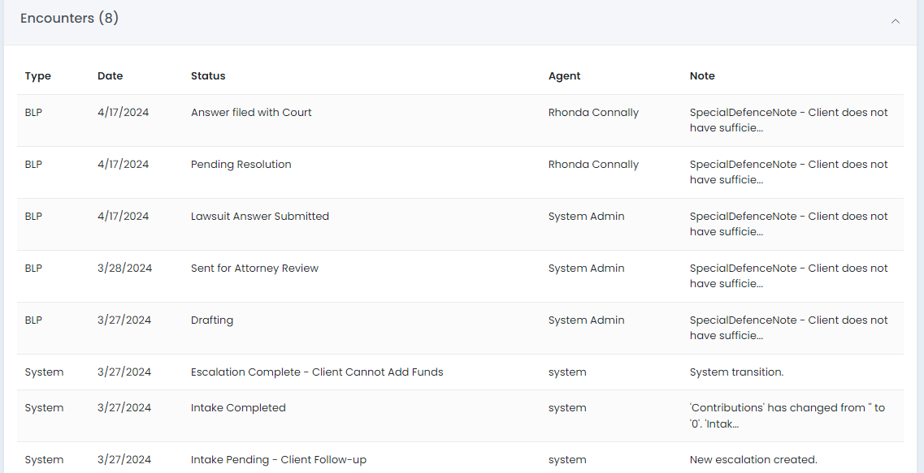
Post Intake Check-Ins
No Settlement
Check Creditor Status
Advise of negotiator assigned
Check Creditor Detail/Comments Tab
Settled
Advise of SIF letter on Portal and GH Statement for proof of payments
Send email to Evan asking for an update
BLP Activity
Check under Encounters on the intake form

